Slide 1
Structure Investigation of Fam20C, A Golgi Casein Kinase
Sharon Grubner
National Taiwan University
Fifth Weekly report – July 24th, 2013

Slide 2
Progress
Clustering
Prepared a pdb file with the verified active site residues for clustering
Have been struggling with issues submitting clustering jobs to GROMOS Clustering
Started preparing files and clustering through g_cluster in Gromacs package
Currently working on solving issues with g_cluster
FTProd
Successfully installed the plug-in developed by the Amaro lab to be used after clustering is complete
Practiced using the plug-in
RMSF
Started learning how to use Ptraj in AMBER tools to calculate RMSF for key residues and loops in Fam20C
Used a short script to calculate RMSF through VMD TK Console
Started writing my observations and qualitative analysis from the results I got thus far
My progress is being updated on a daily basis and shared with my mentors on Evernote.

Slide 3
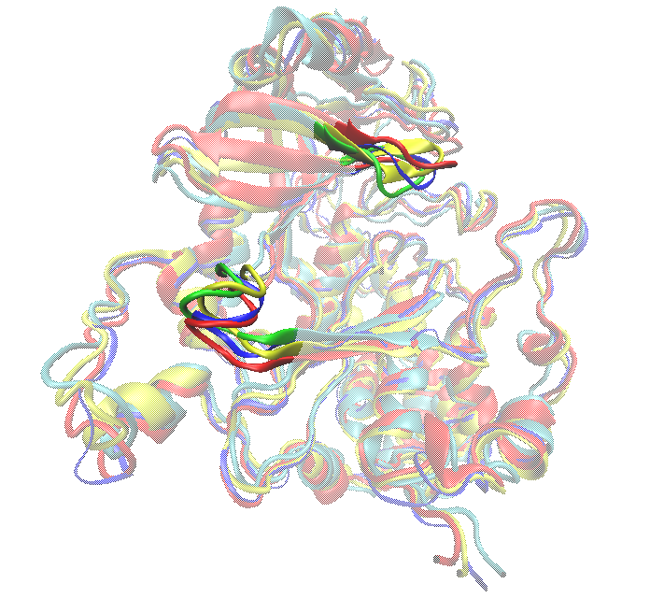
Frames 500 (green), 1000 (yellow), 2500 (red) and 4000 (blue) aligned by alpha carbons of Fam20C kinase. The P-loop (top) and C-terminal lobe (bottom) are highlighted.

Slide 4
Goals for Next Week
Clustering
Keep trying to fix the errors and complete clustering for Fam20C trajectory
FTMap and FTProd
Once clustering submission is complete, start analyzing the unique conformation snapshots through FTMap and FTProd
Hinging of Phe297
Check how much the “hinging” backbone atoms move
Check how much the ring of Phe297 moves

Slide 5
Major Successes and Roadblocks
It has been very challenging to learn how to use multiple new tools and programs independently. Since the people in my host lab are unfamiliar with these tools I use the internet as my major source of information along with asking my UCSD mentors questions about things I am still unclear about.
I have been struggling with using the online form to submit GROMOS clustering jobs for over a week. After discussing with my mentors it was decided that something is wrong with the tool itself and now I am learning how to use g_cluster for the same purpose.
Despite spending a lot of time on trying to fix technical issues and program errors, I am learning a lot and love thinking creatively when trying to come up with new solutions.

Slide 6
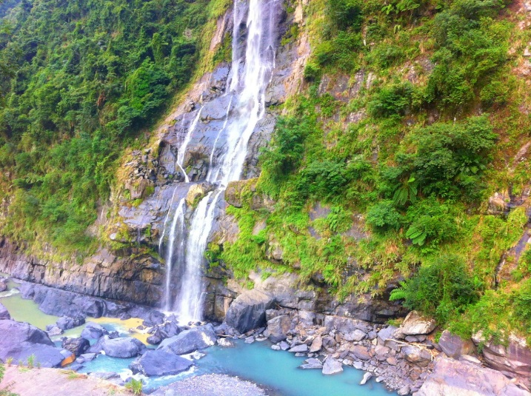
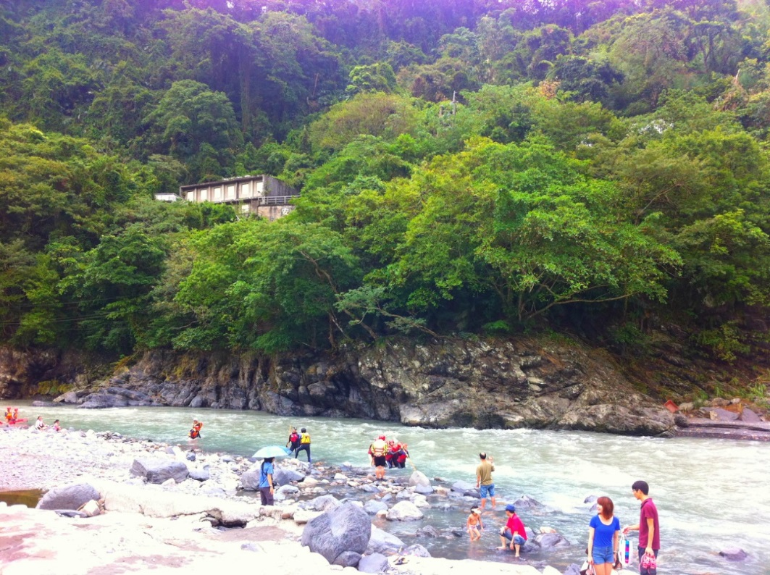
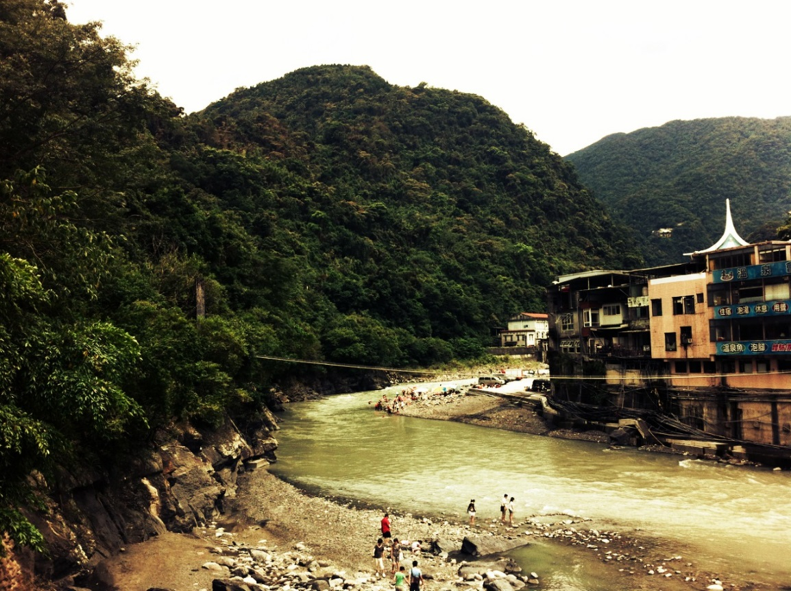
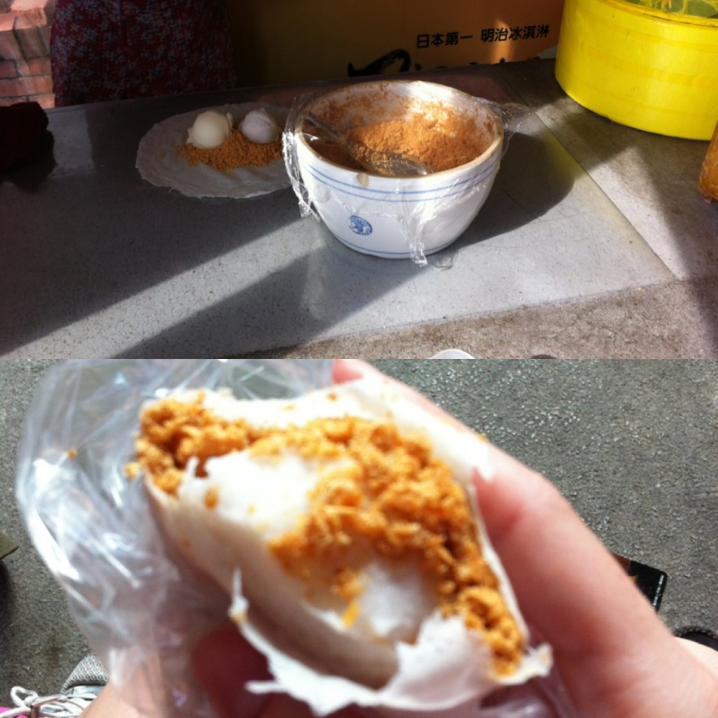
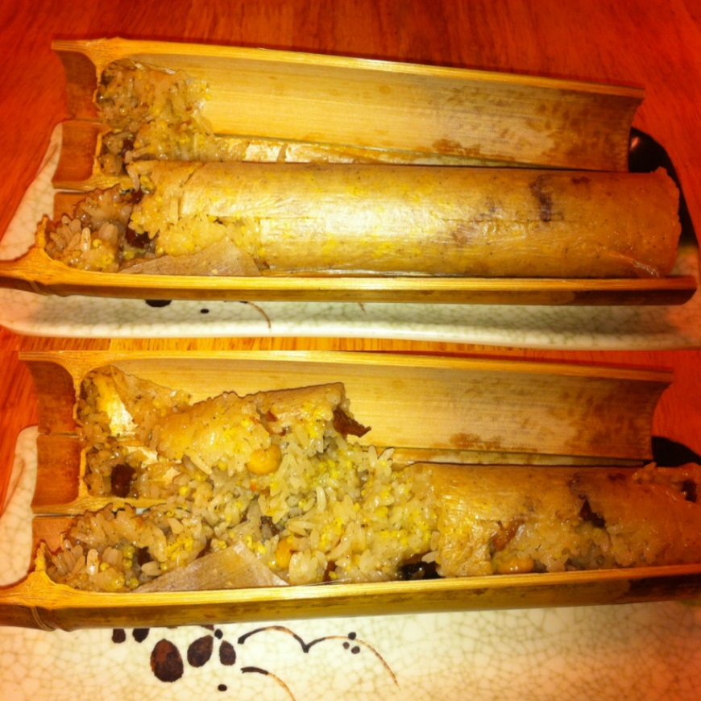
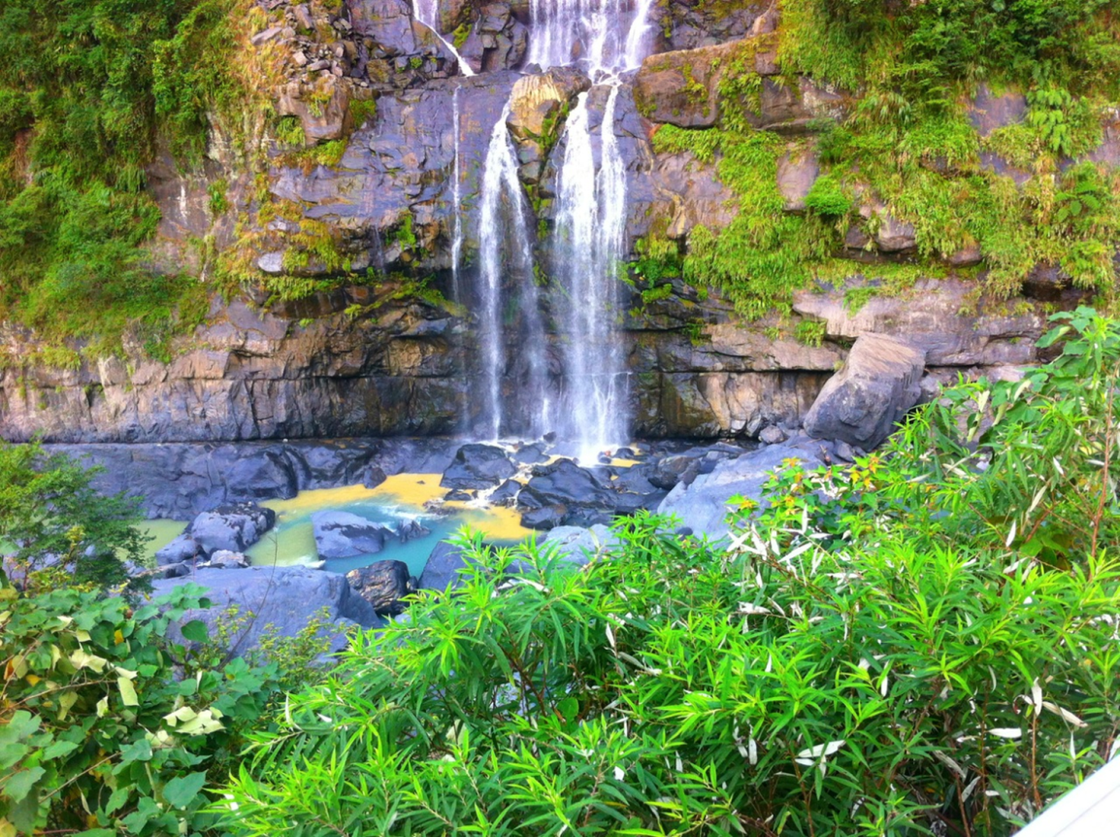
Culture
Wulai
Ice cream with peanuts rolled in thin dough
Bamboo rice

Slide 7
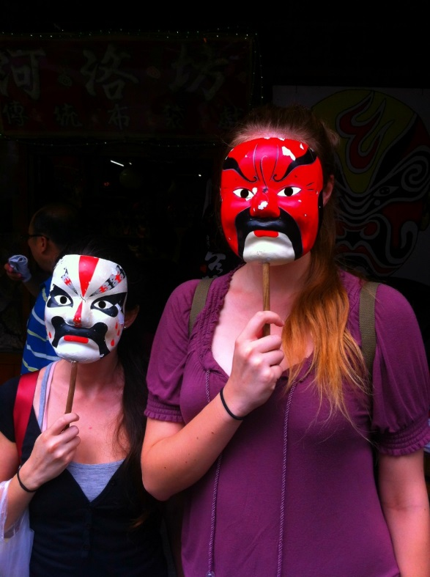
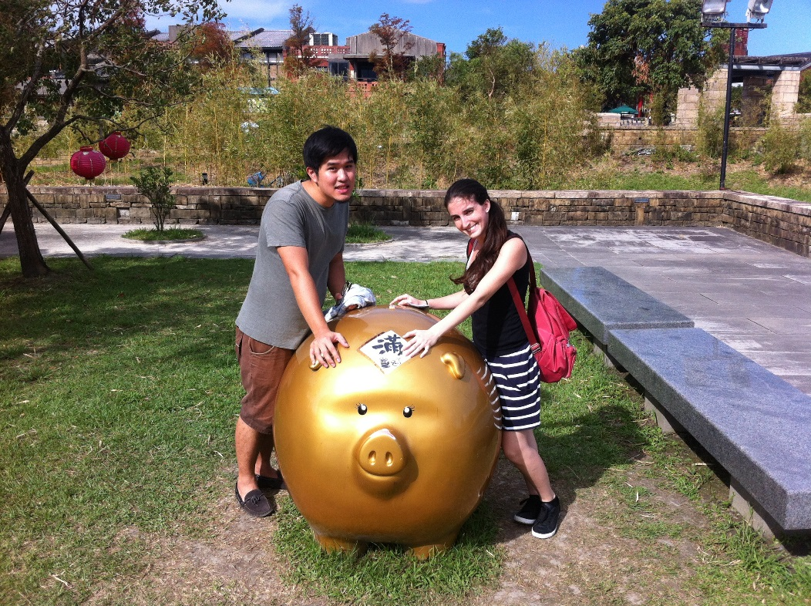
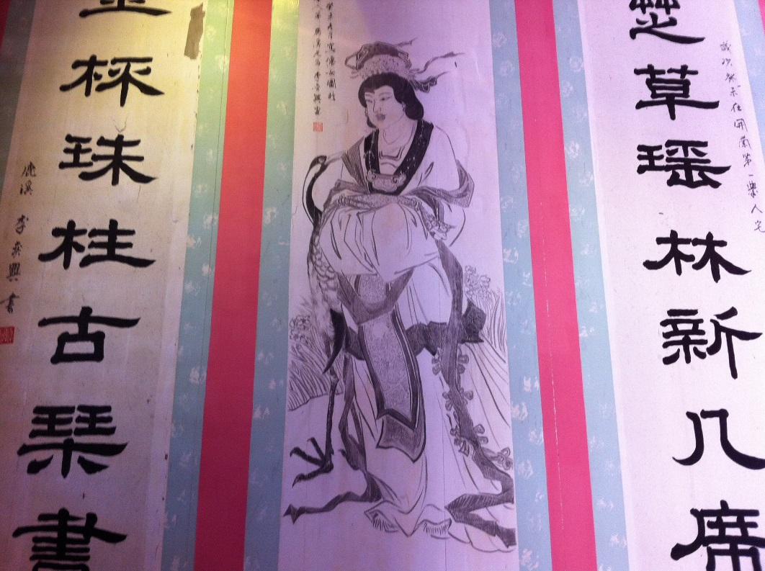
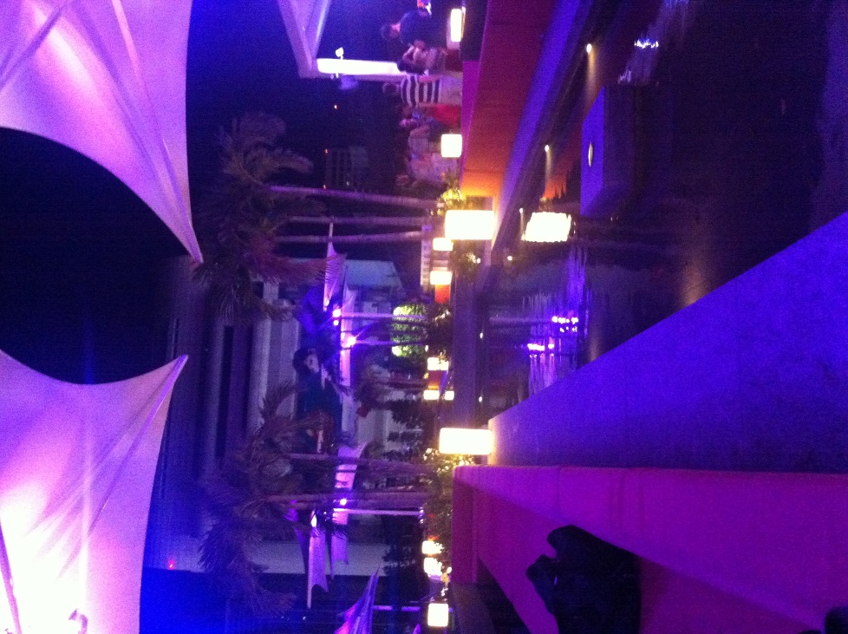
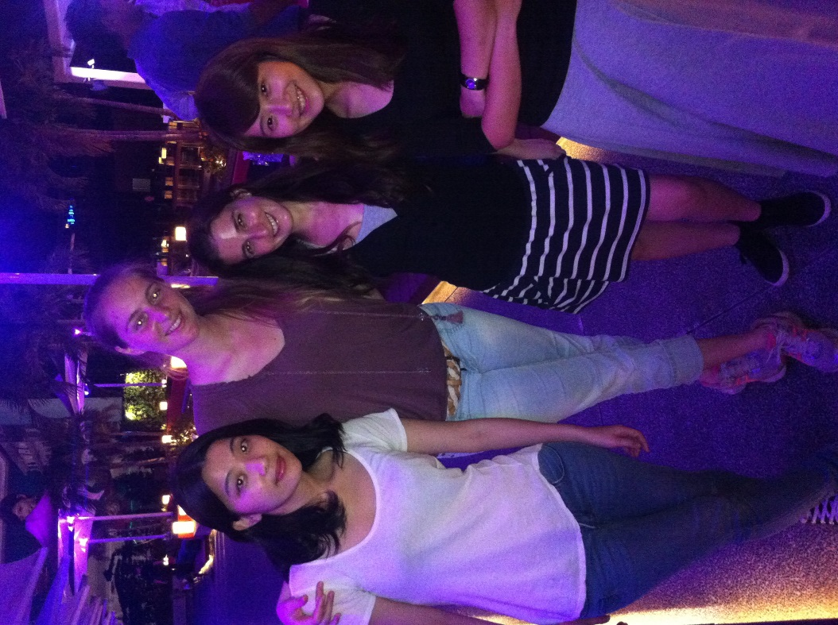
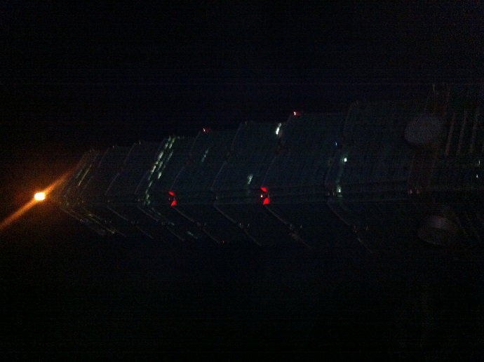
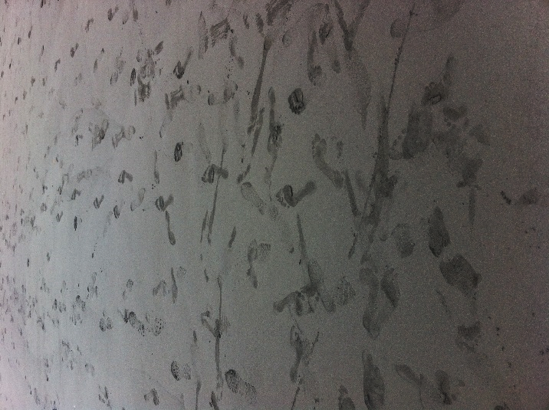
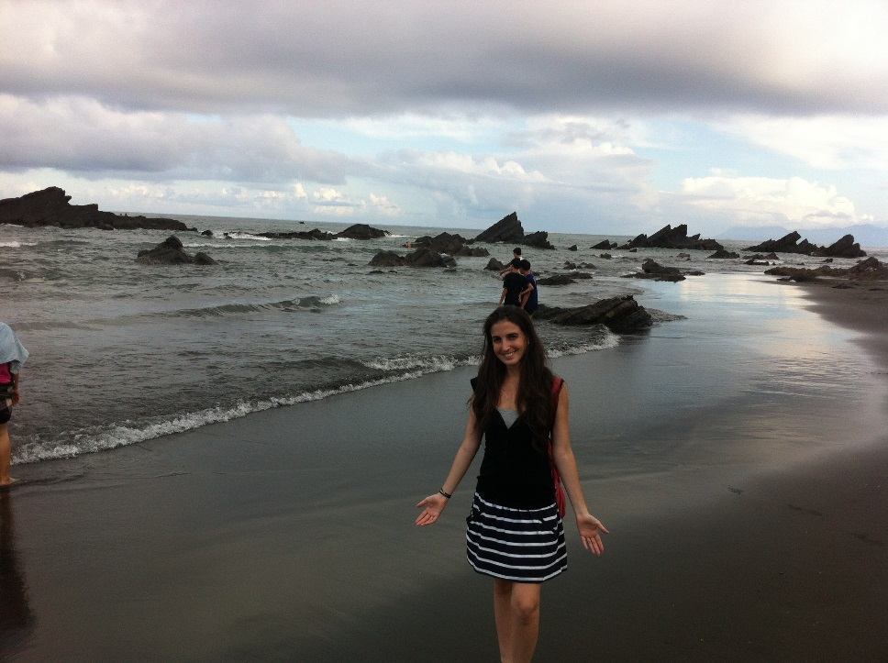
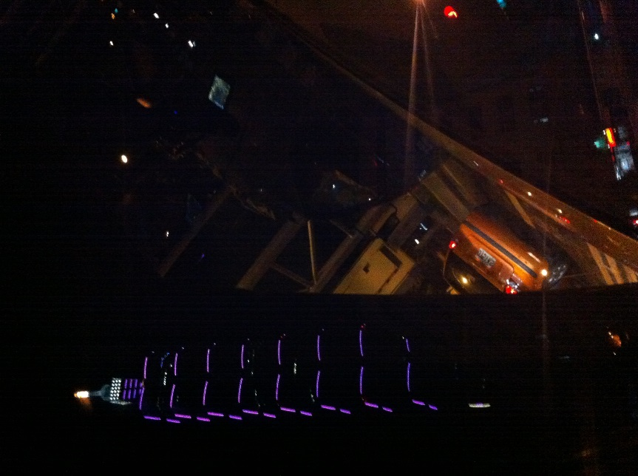
National Center for Traditional Arts, Yilan
Beach close to Yilan
A beautiful rooftop restaurant right next to Taipei 101

Slide 8
Acknowledgments
UCSD (University of California San Diego)
Dr. Rommie Amaro
Dr. Gabriele Wienhausen
Dr. Peter Arzberger
Teri Simas
NTU (National Taiwan University)
Dr. Jung-Hsin Lin
Julia Brown Research Scholarship

